Slide 1
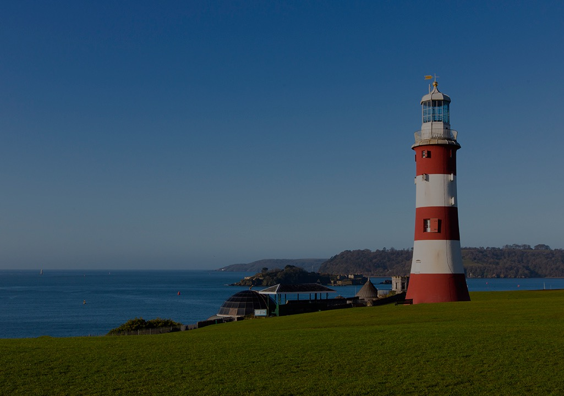
COMP1004 Analysis : Requirements Analysis
Dr Shirley Atkinson

Slide 2
Session outline
Introduce Requirements Analysis
Consider how analysis models differ from requirements
Consider what makes a good analysis
Introduce Modelling
Consider use case scenarios and user stories

Slide 3
Recommended reading
UML @ Classroom
Chapters 1 and 2
Introduction
Short tour of UML

Slide 4
Requirements Analysis
Also need to know what it should NOT do
Identifying what a system should do is first step
How do you do that?
Last week you practiced pulling out functional requirements
Bought together into a project vision
Requirements gathering uses different sources for information
Existing system
Documentation
Information from key users – interviews, observations
May need to deal with competing views

Slide 5
Categories of requirements
Quick reminder from last week
Functional vs non-functional
Safety and security (system security)
Quality, domain, interoperability, CRUD
High level vs detailed

Slide 6
Functional
During practical’s last week you would have picked out the functional requirements
The statements of services that the system should provide
How the system should react to particular inputs

Slide 7
Refining
From the high level, need to consider more detail
Maybe not quite enough to write software from
Need to add in what it will NOT do
Requirements Refinement
System must be able to respond to an invalid user-id / password. The system should display the error message X. It should not allow access to the system

Slide 8
Non-functional
Quick reminder from last week
Constraints on system services
Reliability, availability, performance, efficiency, usability
External requirements
Social, legal, ethical, interoperable

Slide 9
Non-functional examples
Performance criteria such as desired response times for updating data in the system or retrieving data from the system
Ability of system to cope with high level of simultaneous access by many users
Availability of system with the minimum of downtime
Time taken to recover from a system failure
Anticipated volumes of data, either in terms of transaction throughput or of what must be stored
Security considerations such as resistance to attacks and the ability to detect attacks

Slide 10
Usability Requirements
Those requirements that will ensure there is a good match between the system developed and the users being able to achieve their goals when using the system
International Organisation for Standardisation (ISO) definition:
“The extent to which specified users can achieve specified goals with effectiveness, efficiency and satisfaction in a specified context of use”

Slide 11
Usability examples
After 30 minutes of training a new user will be able to perform.. In less than 15 minutes with less than 5% error rate
The system will present X data in centimetres
Users will give an 85% average satisfaction rating on the user satisfaction questionnaire
Many aspects of user interface are subjective or intangible. You could use a questionnaire to provide a quantitative assessment
Usability is testable! Not vague notion of user-friendliness

Slide 12
Functional vs usability
Functional
The library counter staff should be able to process book loans
Usability
An experienced member of the library counter staff should be able to process a normal book loan with no error and within 30 seconds (95%) of the time

Slide 13
Legal
A mistake often made by novices is that they think there is nothing that applies to their project/software
A number of possible legal requirements
GDPR
Disability discrimination act
Computer Misuse Act
Sarbanes-Oxley
Obscene publications
Sale of …. To minors

Slide 14
Social & Ethical
Requirements may relate to:
Privacy
Safety
Decency
Pollution
Sustainability

Slide 15
Interoperability requirements
System may need to provide a service to a pre-existing system
The system may need to employ a service provided by a pre-existing system
The system may need to employ existing data stores and therefore be constrained by the format of these.

Slide 16
Non-Functional Requirements
Technical : Web based application interacting with lights in SMB109. Data hosted on remote server provided. Interface for student is browser based but for Lecturer is mobile.
Performance : Response times not within scope.
Usability : Interfaces to conform to accessibility rules
Reliability : Outside of scope
Security : OWASP top 10 to be addressed where appropriate. Lecturers log in but students do not. Name info only for lecturer
Why?

Slide 17
Finding it all out
Background reading
Interviewing
Observations
Document sampling
Questionnaires
Focus groups

Slide 18
Questions to ask
To understand the operations and processes
Ask ”What do you do?”
Understand how operations should be performed
Ask “How do you do it?”. “What steps do you follow?”
Understand what information is needed to perform these operations
Ask ”What information do you use?”, “What forms or reports do you use?”

Slide 19
Confusing user requirements
A functional requirement
To assist customers in identifying appropriate items for purchase whilst browsing the online store, the system will provide a facility whereby the customer can view recent purchases (either for the last month, last quarter, or last year). Initially this facility is off, but may be turned on/off at any point during the browsing session, and can be toggled between last month, last quarter and last year at any time…
UI issues
Too much detail!

Slide 20
Re-written
Note the numbered requirement
2.4.5 Recent purchase view
The system shall provide a facility whereby customers can view recent purchases whilst browsing the online store
Rationale:
This facility helps the customer to make better purchasing choices
System requirements reference:
OnlineStore/Section 4.1
Proposer:
Fred Bloggs, Plymouth Office

Slide 21
Writing Techniques
Simple structured text
Use diagrams
Use case descriptions describe actor-system interactions
Sequence and communication diagrams to describe object interactions
Statecharts to describe state-dependent behavior
Techniques for specifying algorithmic requirements
Covered later in module

Slide 22
Requirements elicitation
Is working with stakeholders to find out about the application domain and requirements
Activities in the application domain may yield system services
Things in the domain may need to be represented in the system

Slide 23
Elicitation : Viewpoints
Stakeholders have different viewpoints on the system and will see the problem in different ways
They will structure the elicitation process and requirements themselves
A win condition for a particular stakeholder is a requirement that is considered critical by that stakeholder
Conflicting win conditions are potential problems/risks

Slide 24
Elicitation : Interviews
Different stakeholders can provide differing types of information
High level management : the strategic view
Middle management : Overview of business process
Operational management and users : details of the business processes, operational problems
Users sometimes get stuck in the details of how their job is currently done
Plan carefully how you need to speak to, why and when
They will not thank you for wasting their time
Do not spend time asking for things in interviews that can be gained from elsewhere

Slide 25
Conducting interviews
Prepare yourself and your interviewee beforehand
What information are you expecting from them?
Record the contents of the interview
Summarise the points made in order to ensure that they have been understood – clarify facts vs opinions
Provide at least some opportunity for the interviewee to raise issues of their own
Ask ”who else can provide information”
Do NOT promise to include something they ask for in the system
Afterwards write it up, get the interviewee to confirm the details and clarify if the notes can be made public

Slide 26
Elicitation : Questionnaires
Often used when number of stakeholders is too large
Invite all or a sample to complete the questionnaire
Only a fraction will actually respond
Web-based questionnaires are easier to construct and analyse
Closed questions are most commonly used and the data most easily analysed
Questions must be crystal-clear as there is limited opportunity for clarification
Consider very carefully in advance what information is required

Slide 27
Elicitation : Observation
Observation of the use of existing systems can provide information about possible system services and wider business processes
Observation of the use of prototypes can help to elicit or validate requirements for the intended system
Can be used to check validity of information from other sources eg interviews.
Captures information that is not consciously held by stakeholders

Slide 28
Elicitation : Document Analysis
Document analysis can provide information about the existing system and domain
Policy manuals, IT systems documentation, business process documents.
BUT documentation often gets out of date

Slide 29
Elicitation : Event modelling
What events does the system need to respond to?
Events are either flow, control or temporal (time-based) depending on how the system becomes aware of the event
Flow oriented – incoming data flow
Control - incoming control flow
Temporal – specified time
Customer order (flow)
Distribution company provides music information update (flow)
Status report requested by store manager (control)
Produce end-of-month sales summary report (temporal)

Slide 30
Elicitation : Business analysis
Consider the business need – their problems and root causes
“Currently the customer service division does a lot of manual work. Each person in the team spends more than a day per week dealing with paperwork, when their primary focus should be customer interaction. Tracing orders, queries and complaints is difficult, and a lot of time is spent manually pulling information together for reporting purposes. When answering a customer call, the customer service agent is not able to see al recent orders, queries and complaints of the current customer, so customers have to repeat information depending on who they get to talk to .. “
Business needs are not system requirements. Business objectives, project objectives and/or system requirements may be derived from the business needs

Slide 31
Elicitation : Business process modelling
Dentist’s appointment system. Event = Patient requests appointment
Patient not found
Register patient
Yields 4 requirements
Book patient appointment
Search for Patient
Register Patient
Schedule appointment
Search for patient
Patient found
Schedule appointment

Slide 32
Requirements management
Business managers and users will happily:
Ask for every possible requirement they can think of
Change their requirements as and when they see fit
They do not consider cost, time, effort or your sanity..
Unless managed this can sink your project
Ensure requirements can be traced back to business objectives
Employ prioritization, staged delivery, cost estimation and change control

Slide 33
Expressing requirements priorities
Use a simple numeric scale
MoSCoW is sometimes seen in literature
Must be included in current delivery
Should be included, but not necessarily in current delivery
Could – would be nice
Won’t – at least in current delivery
Delivery could be a 2 week window (sprint)

Slide 34
Recording information
So you have gathered those requirements
How did you record them?
Need a mixture of diagrams, data and text
You need a model
Models describe systems efficiently and elegantly
A picture speaks a thousand words!

Slide 35
Notes:
https://images.app.goo.gl/EftDXGg29CxLG5zSA

Slide 36
Requirements
Think about what you know about the activities or the tasks being carried out
This is part of requirements modelling
Think about what you know about the essential elements of the requirements
This goes into the requirements model

Slide 37
Requirements -> Analysis
Analysis activities use the documents output from the requirements gathering
Identify what the system must do
An analyst seeks to understand the organisation, requirements and objectives
Designer will seek to specify a system that fits with organisation, provides requirements effectively and assists in meeting objectives

Slide 38
Purpose of analysis
Analysis aims to identify
A software structure that can meet the requirements
Common elements among the requirements that need only be defined once
Pre-existing elements that can be reused
The interaction between different requirements

Slide 39
Analysis & Design
Design
Develop an architectural structure for software components, DB, user interface
Low level design – develop detailed tables, classes, methods and structures
Storyboards are part of this
Design for each aspect of user interface
Each dialog or goal

Slide 40
The Analysis model
The model must confirm what users want a new system to do
It must be:
Understandable for users
Correct scope
Correct detail
Complete
Consistent between different diagrams and models

Slide 41
What an analysis model does
Describes what the software should do
Represents people, things and concepts important to understand the system
Shows connections and interactions among these people, things and concepts
Show the business situation in enough detail to evaluate possible designs
Is organized/structured so it can be useful for designing the software

Slide 42
Modelling
Mapping : a model is always an image, a representation
Reduction : a model does not capture ALL attributes – only those that are relevant
Pragmatism : It needs to be useful. To be useful consider who it is for, why it is being created and what will it be used for.

Slide 43
UML
Unified Modelling Language
A comprehensive set of diagrams that together represent a model of the system
Notes:
https://images.app.goo.gl/gqdDBxyJAwxpYKSr5

Slide 44
UML Models/Diagrams
Use Case is an activity that a system performs in response to a request from a user (AKA functional requirement)
Requirements are modelled with a Use Case Diagram, supporting user stories and descriptions
Create customer order

Slide 45
User story
One short sentence in the every day language of the end user that states what a user does as part of their work
Maps directly to one use case
Template
As a <role played> I want to <goal desire> so that <reason or benefit>
As a Checkout Desk Librarian I want to issue loan items so that I can serve more members quickly
Issue loan

Slide 46
Use Case Diagram : purpose
Document the functionality of the system from the users’ perspective
Document the scope of the system
Document the interaction between the users and the system using supporting use case descriptions

Slide 47
Requirements Validation
User story must have acceptance criteria
1. Member look-up must be by name or member number
2. Current loan items and member status must be displayed

Slide 48
Identifying User stories and Use Cases
Work out who you need to speak to
Identify all potential users for the new system
Classify the potential users in terms of the functional role (stock control, manage members)
Further classify potential users by organisation level (operational, management, executive)

Slide 49
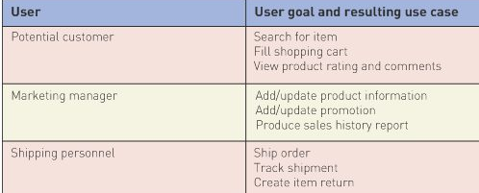
User stories .. continued
Should now have a list of preliminary use cases organized by type of user
Look for duplicates with similar names, resolve inconsistencies
Identify where different types of users need the same thing
Review list with stakeholders

Slide 50
Event decomposition technique
Consider the types of event in the system environment that requires a response from the system
For each external event identify and name the use case
Consider temporal events that require a response from the system
For each temporal event, identify and name the use case, establish a point of time that triggers the use case
Consider the state event that system might respond to

Slide 51
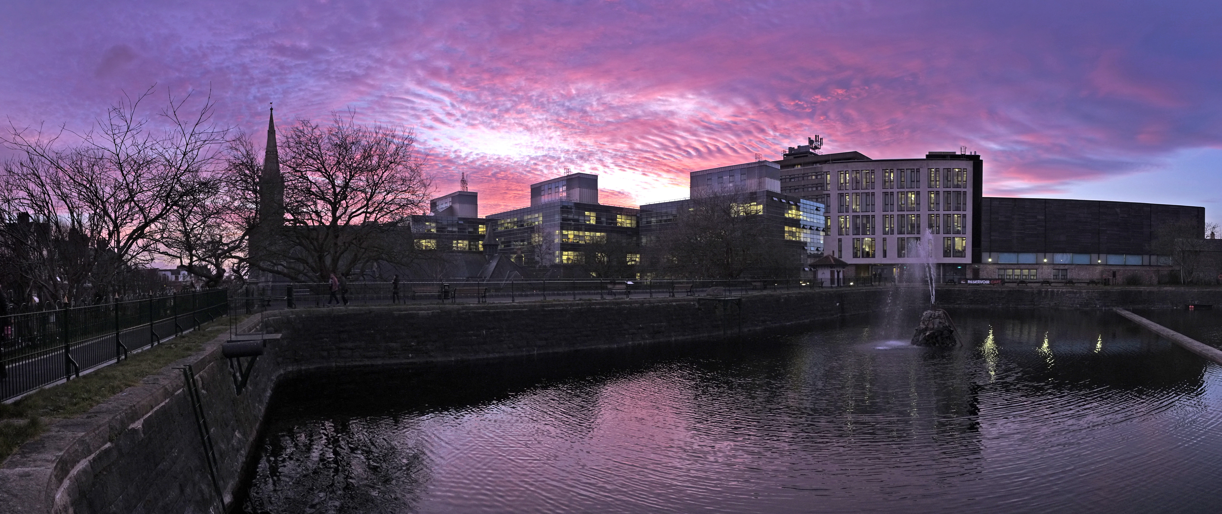
Any Questions?

